Slide 1







DELFT 3D
Cool approach in Oceanic Modelling

Slide 2
Typhoon Halong(2008)
In depth Storm Surge Modelling

Slide 3

Typhoon Overview
Formation | Typhoon Halong, also known as Typhoon Cosme in the Philippines, was a significant weather event in May 2008.
Development | It was designated as a tropical depression by the Japan Meteorological Agency (JMA) and the Philippine Atmospheric, Geophysical, and Astronomical Services Administration (PAGASA) on May 14.
Intensification | The storm was upgraded to a tropical storm on May 16 and reached its peak intensity as a severe tropical storm on May 17.
Landfall | Halong made landfall in the Philippine region of Pangasinan on May 17, causing significant damage.
Dissipition | The storm weakened as it moved over Luzon and eventually transitioned into an extratropical cyclone by May 20.

Slide 4
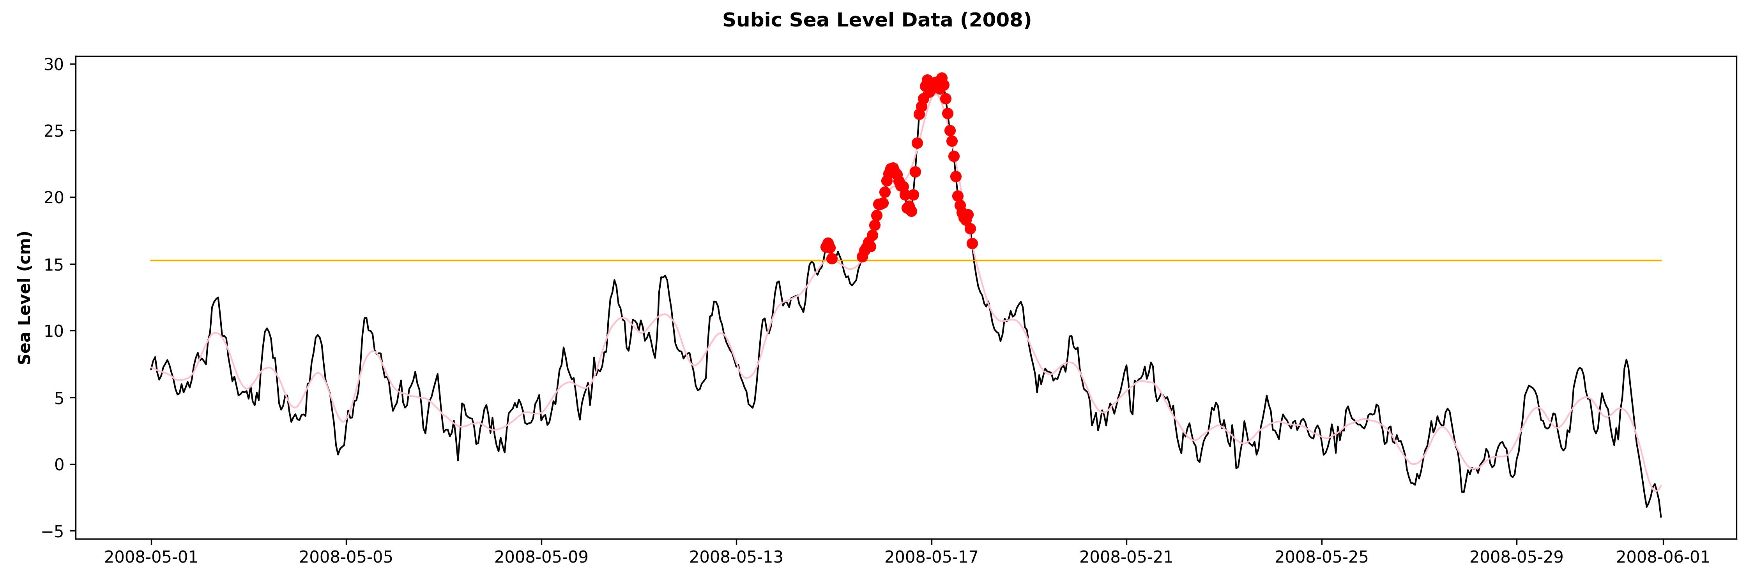
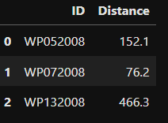
Storm Surge Identification
01

Slide 5
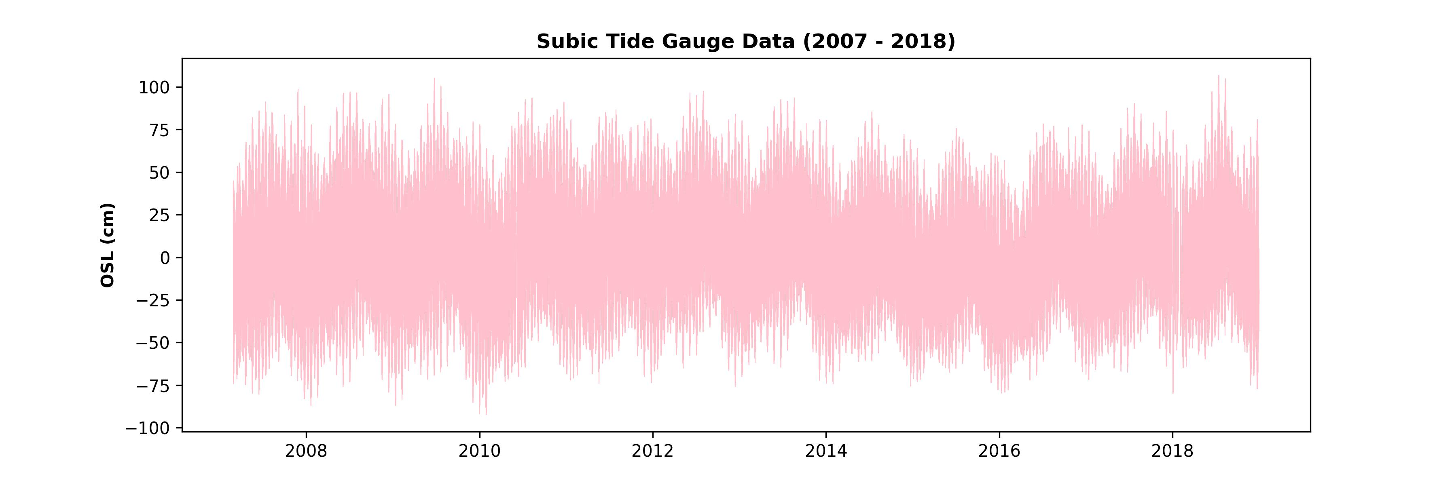

Experiences

Slide 6
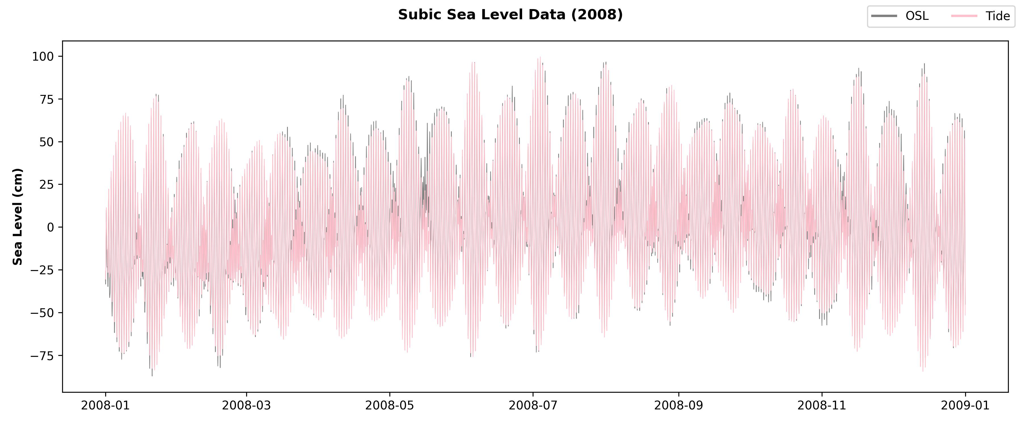

Slide 7
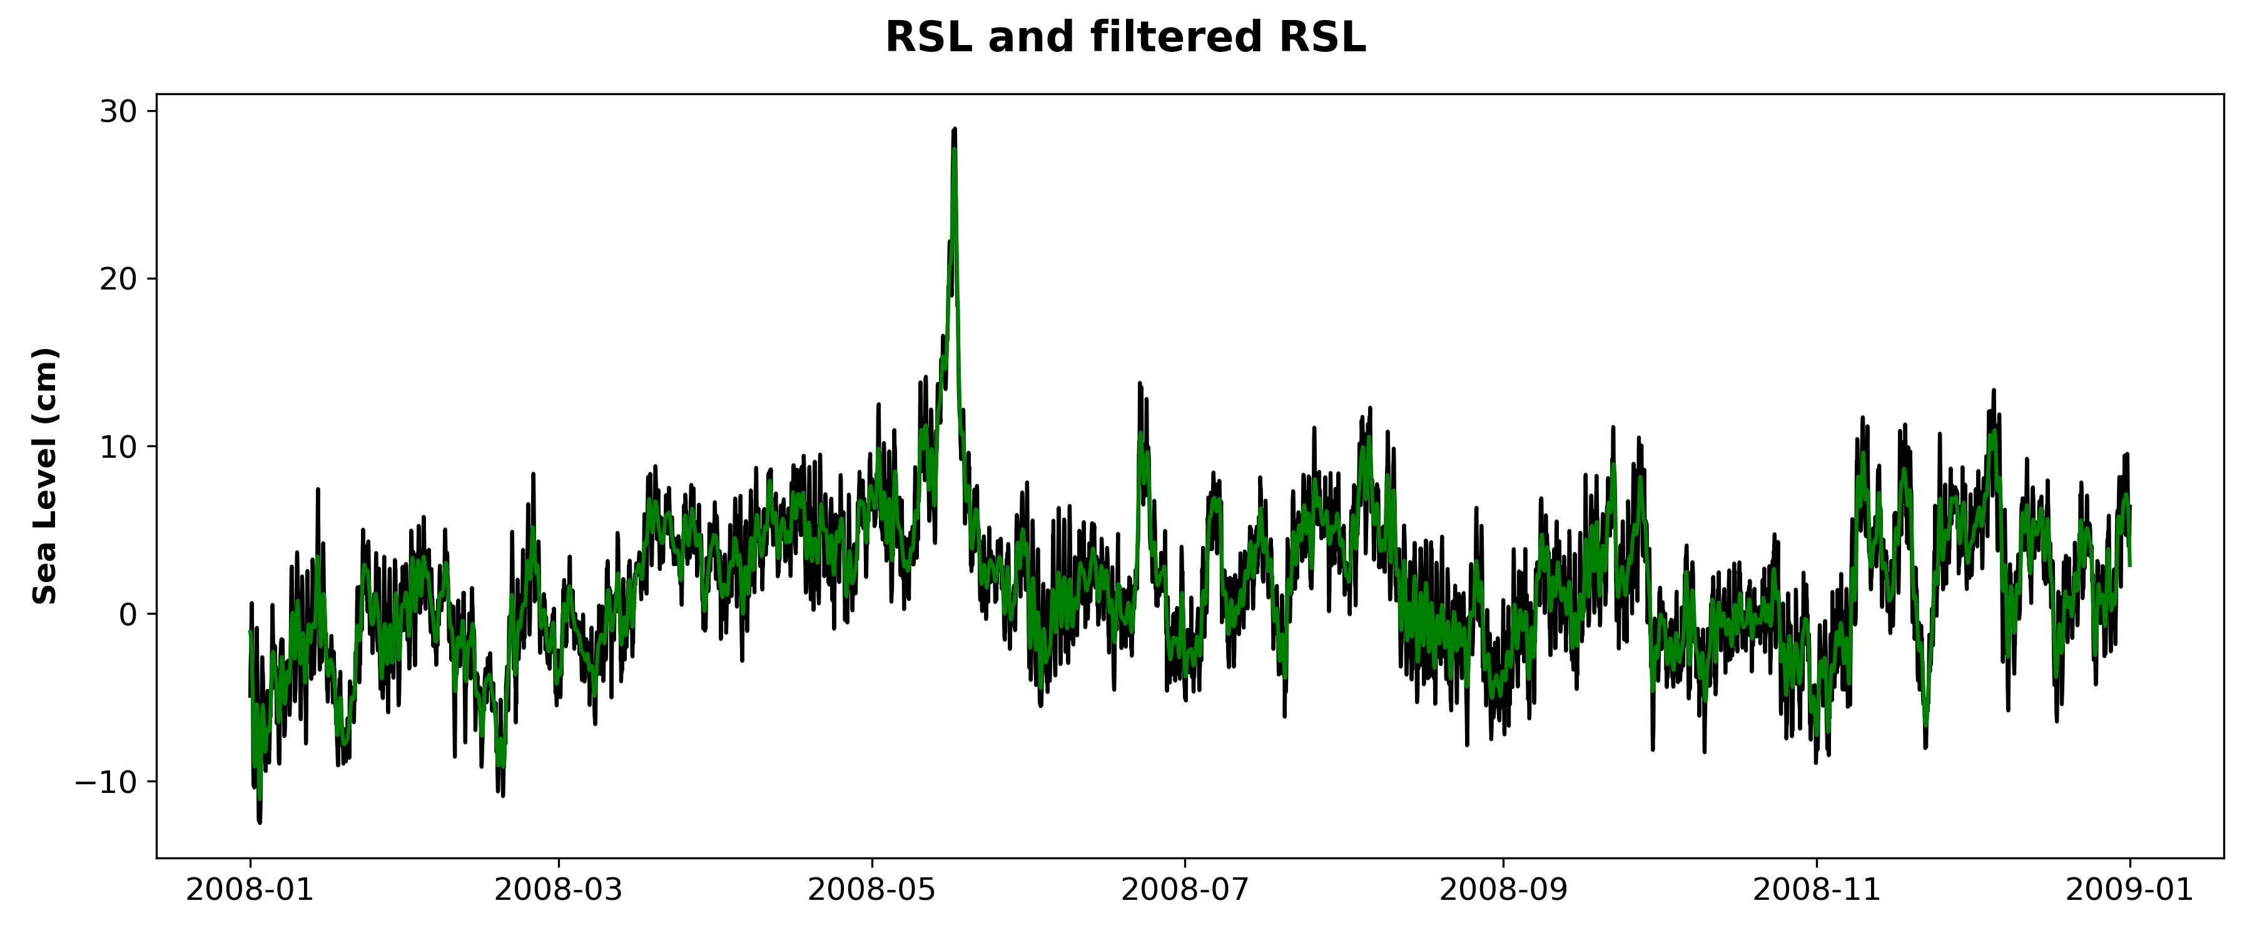

Slide 8
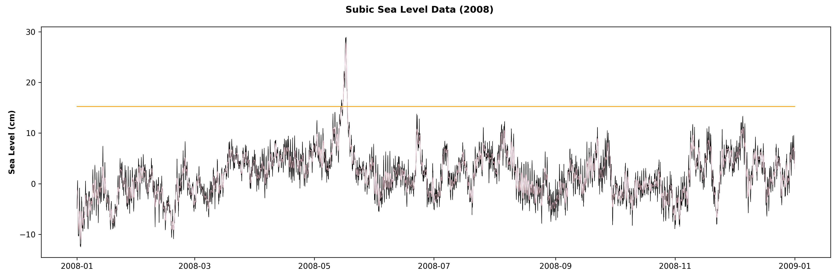

Slide 9
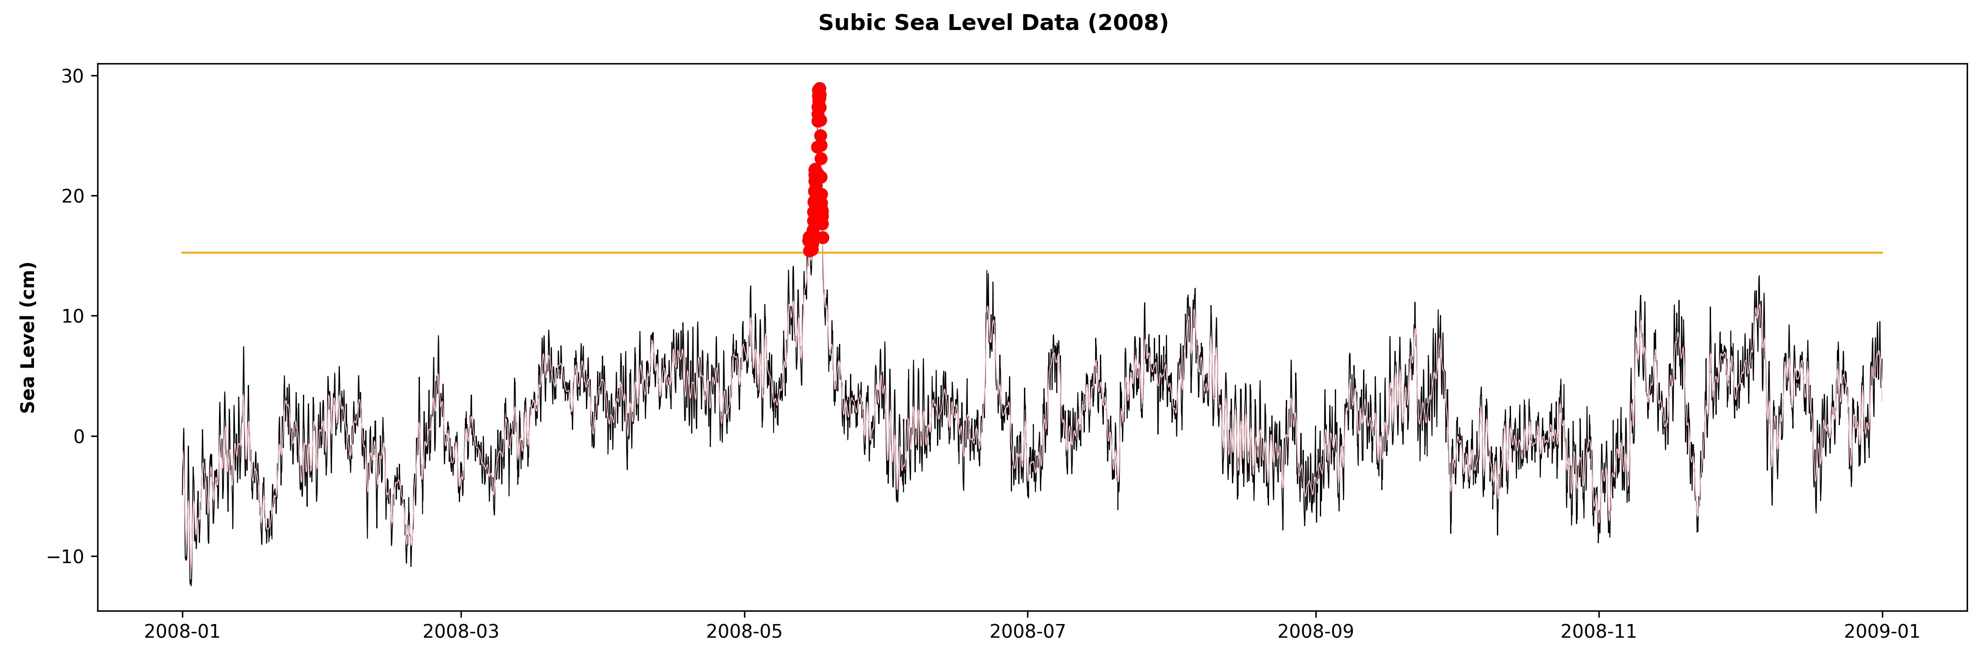

Slide 11
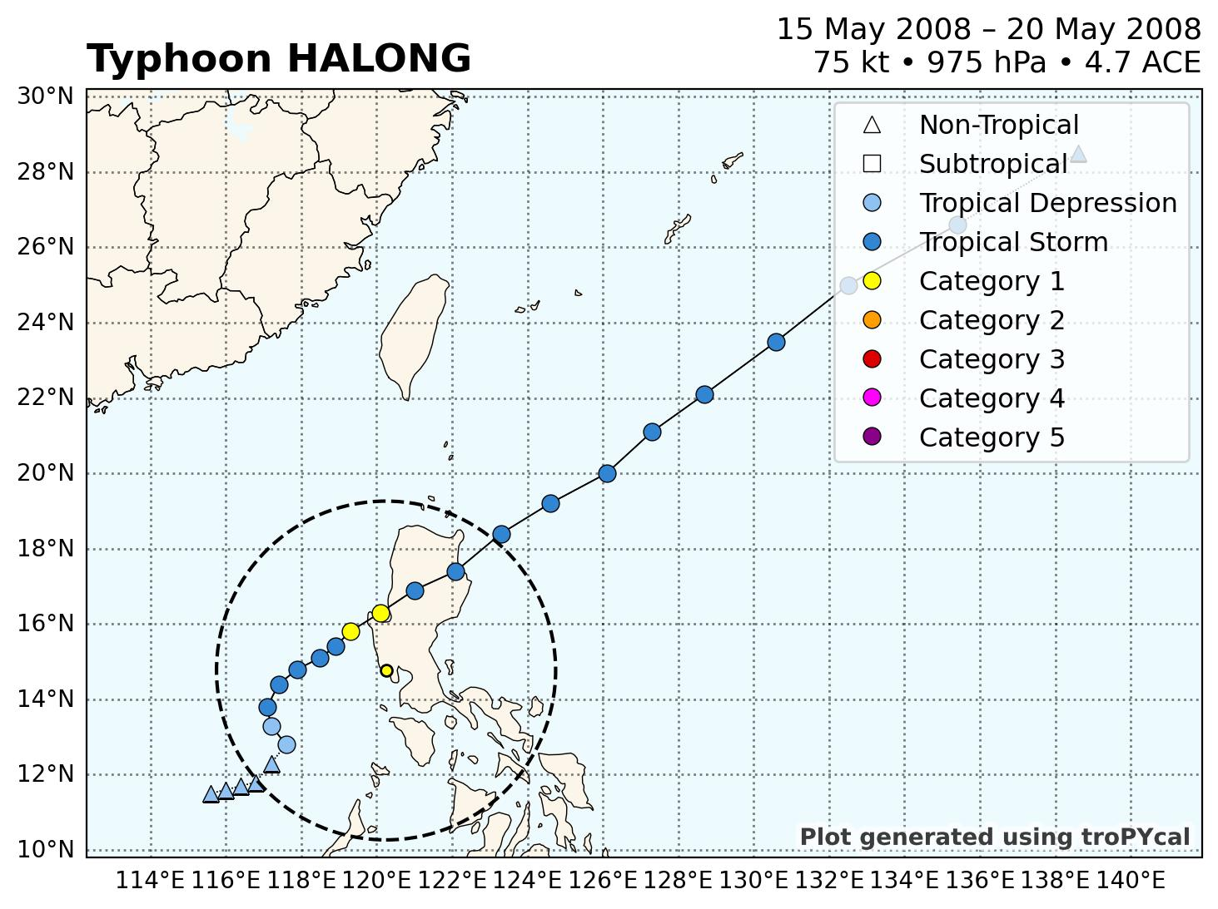
Typhoon Track

Slide 12
DELFT 3D MODELLING
02

Slide 13
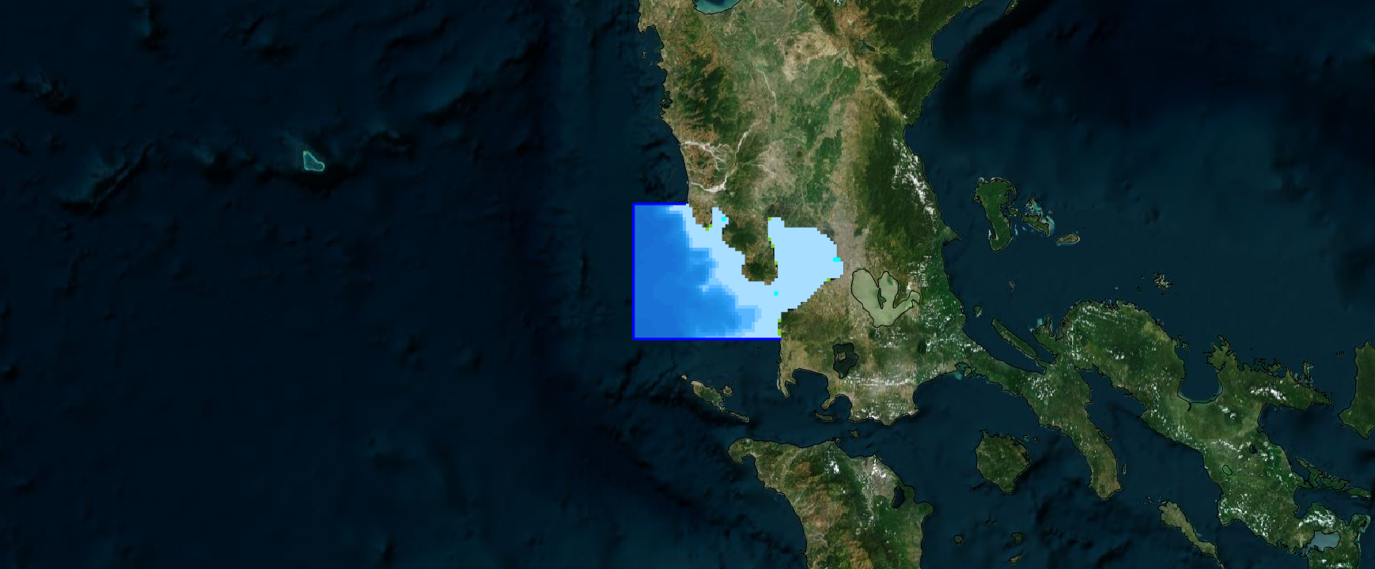
Model Overview
The model Extends from Manila Bay to Offshore, encompassing the Subic station

Slide 14
Settings
Grid | 64 x 40
Resolution | 2,100 m
Bathymetry | GebCo 19

Slide 15
INITIAL RUN
03

Slide 16
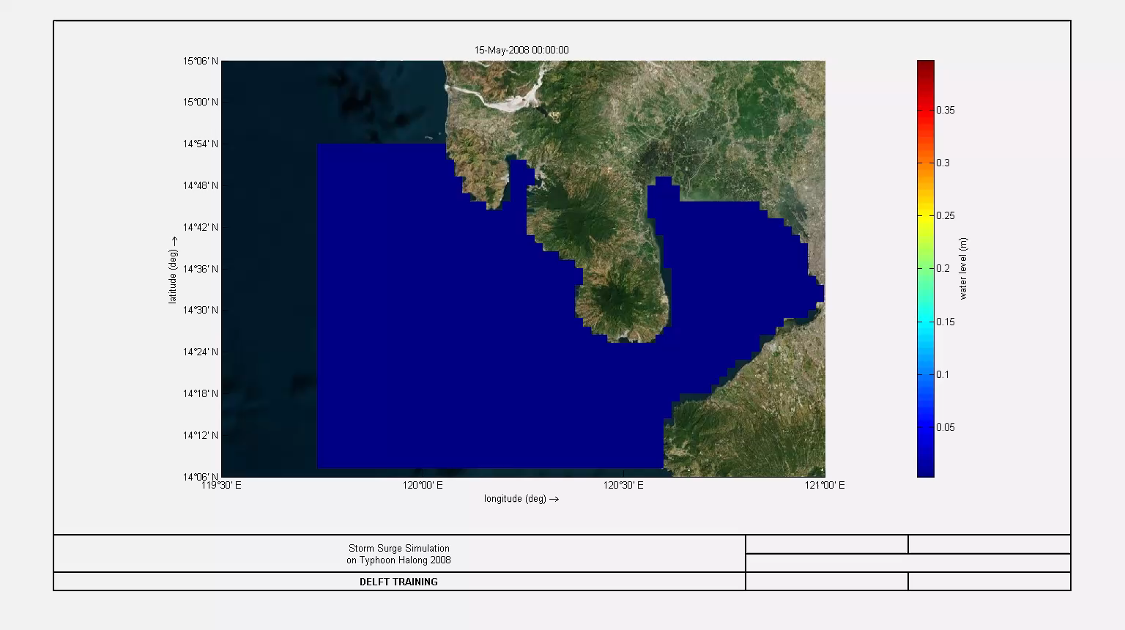
Tide Results

Slide 17
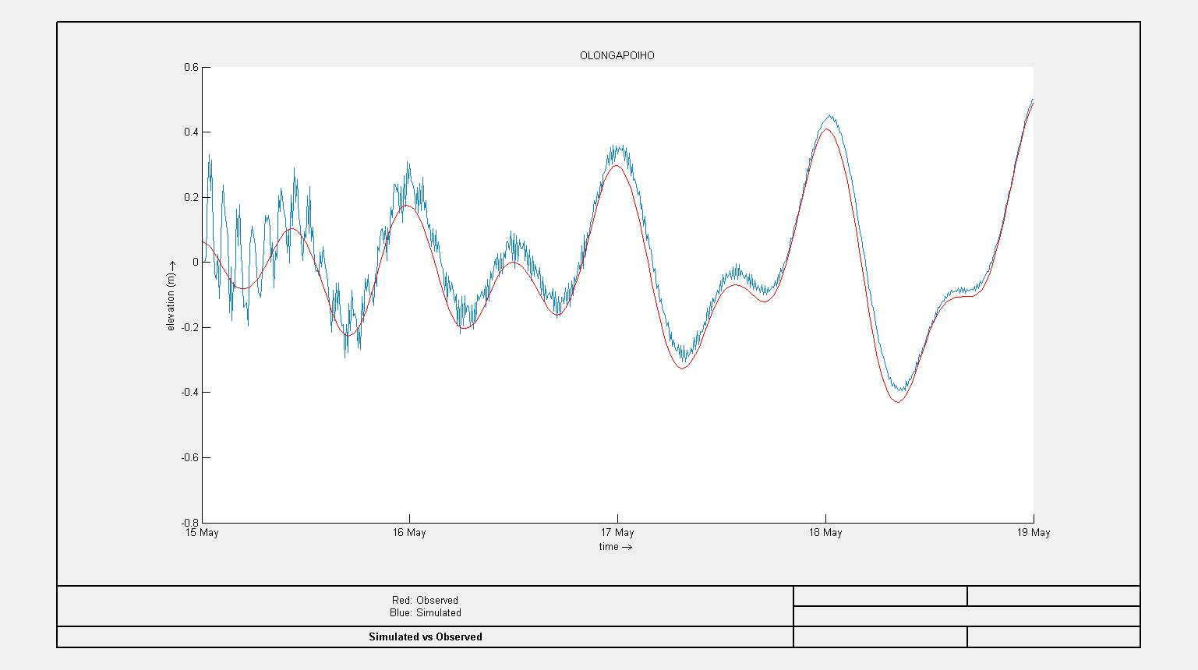
Tide Validation

Slide 18
STORM SURGE
04

Slide 19
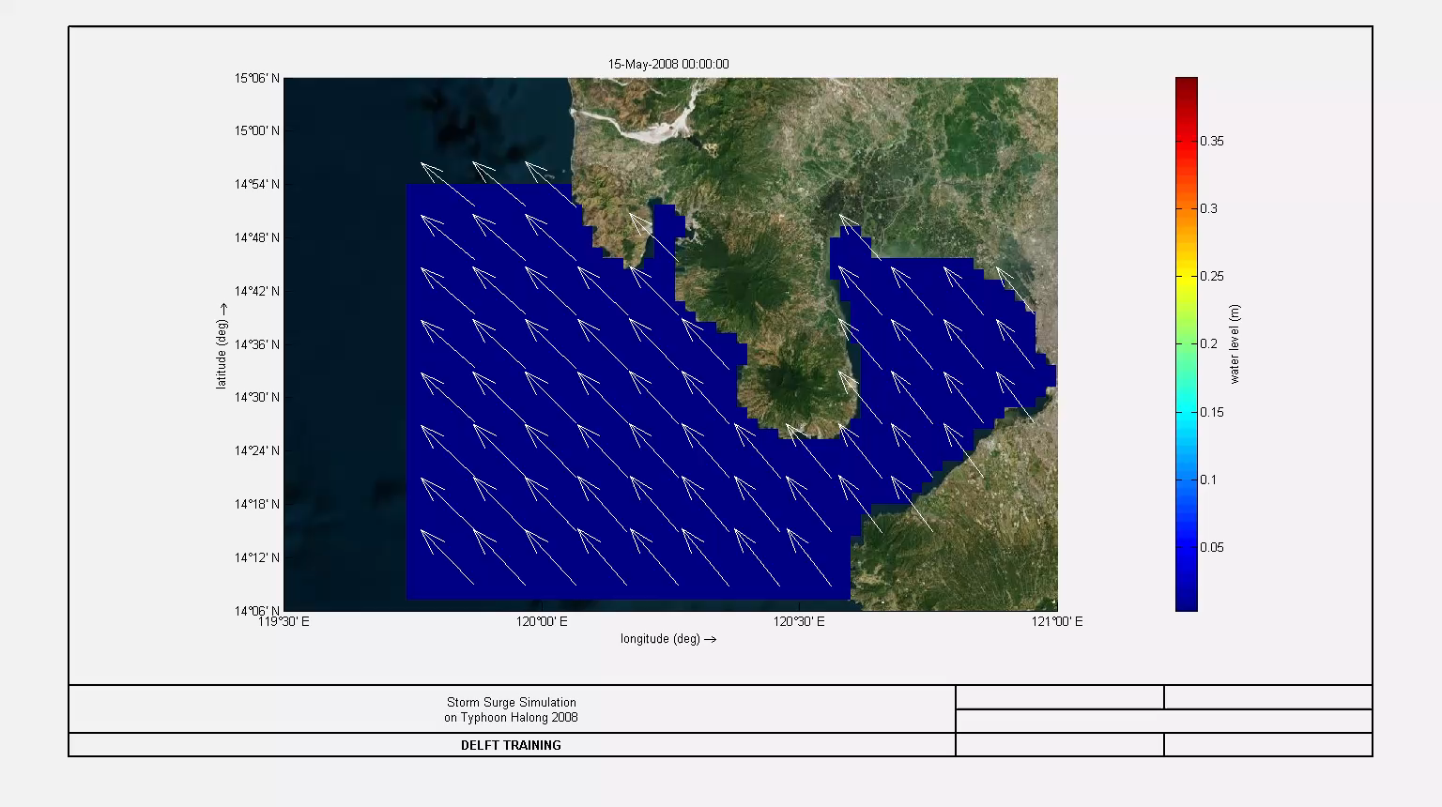
Storm Surge Results

Slide 20
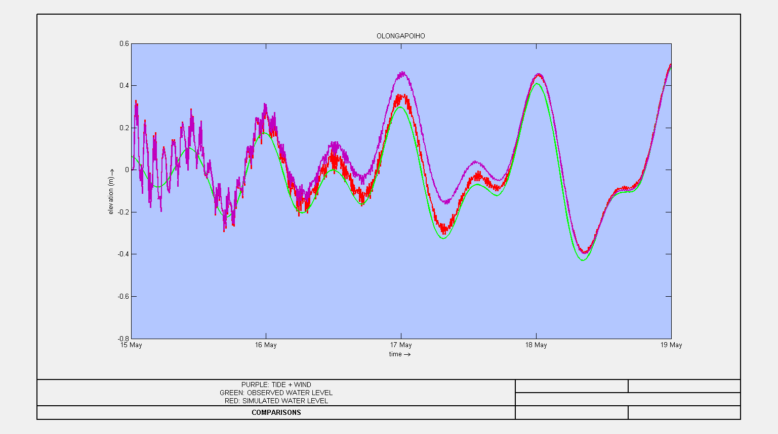
Storm Surge Validation

Slide 21
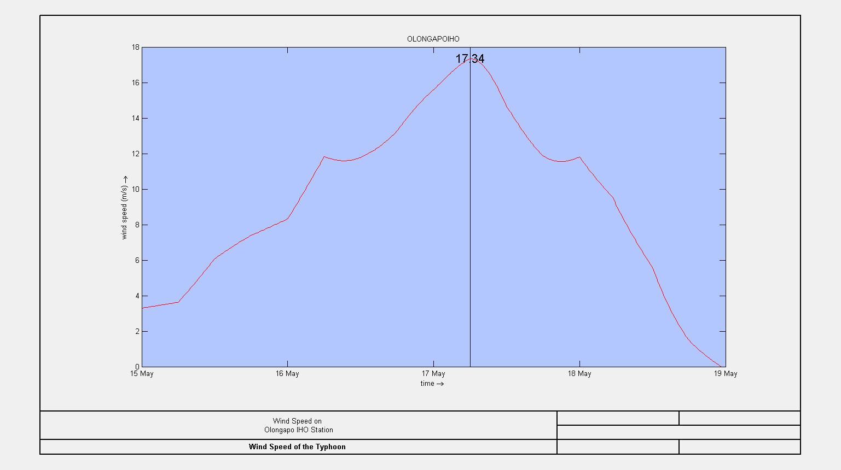
Wind Speed

Slide 22
WAYS FORWARD (DELFT FM)
05

Slide 23
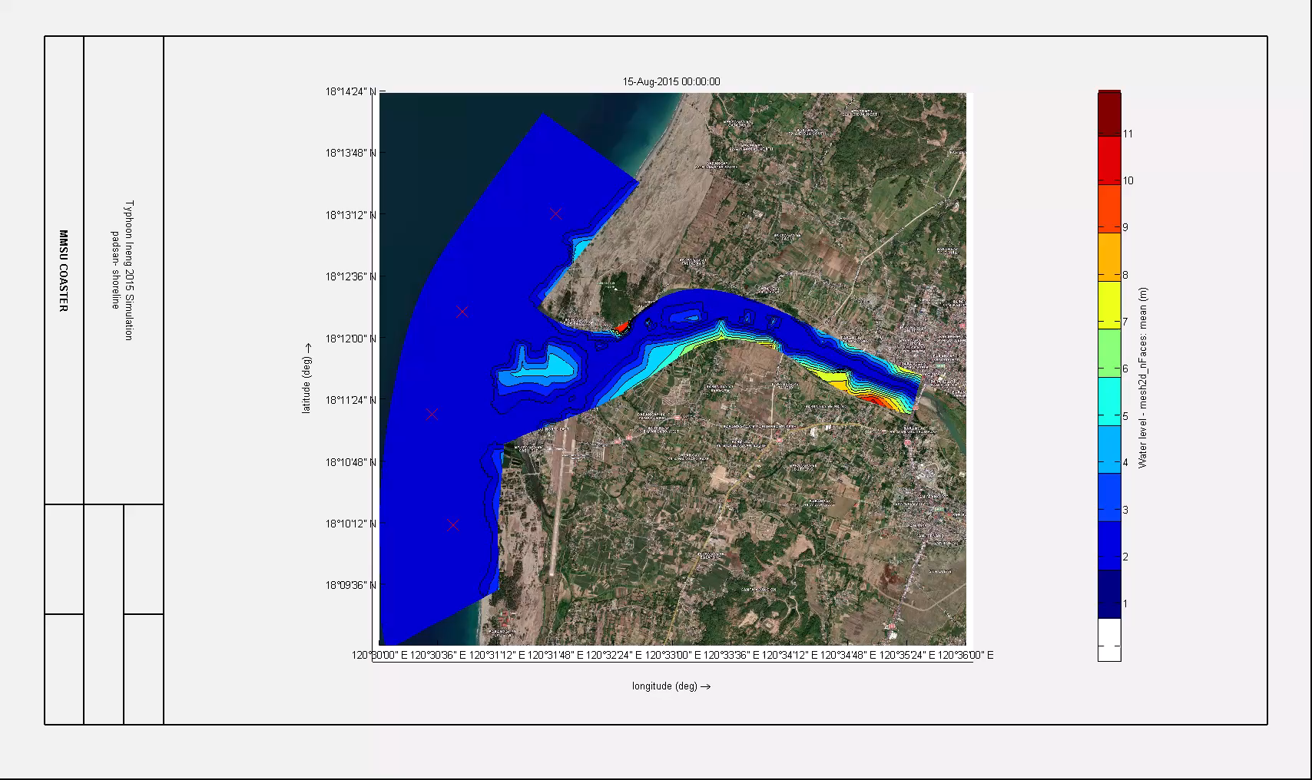
Coaster Tide Model on Padsan

Slide 24
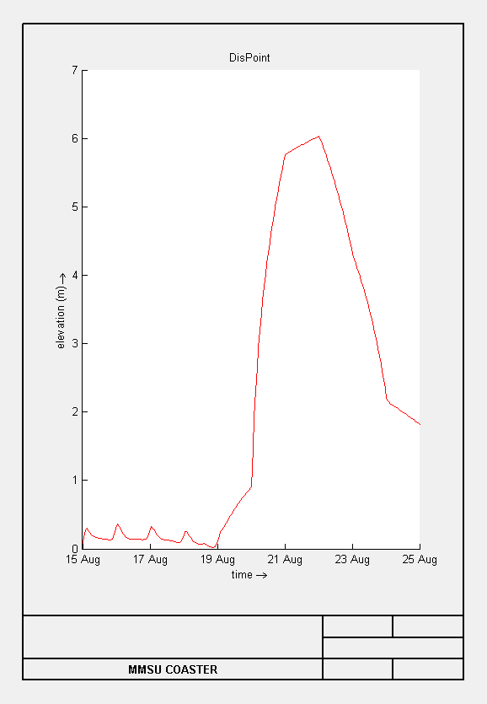
Coaster Tide Model on Padsan

Slide 25
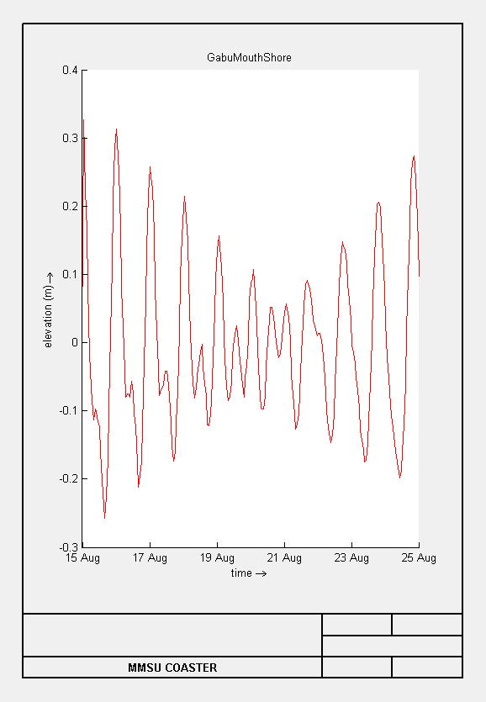

Coaster Tide Model on Padsan

Slide 26
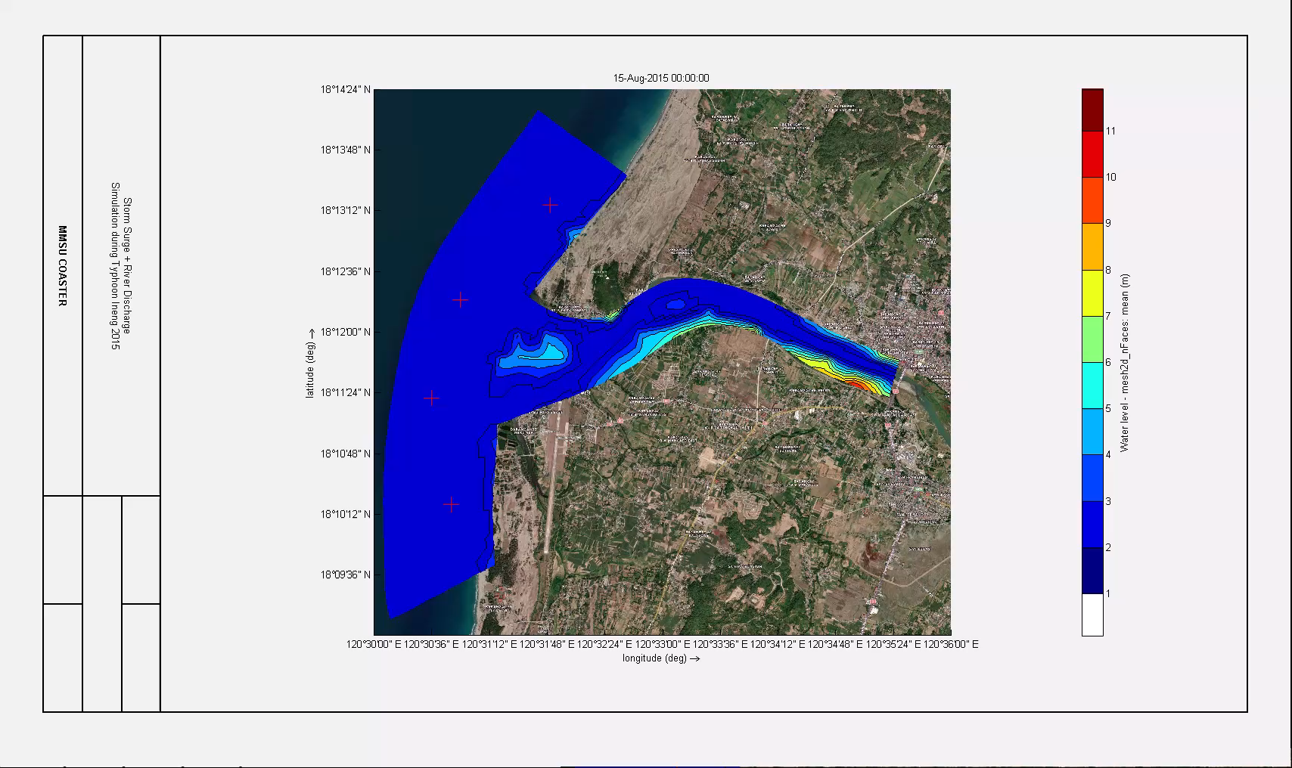
Storm Surge Model on Padsan with Discharge

Slide 27
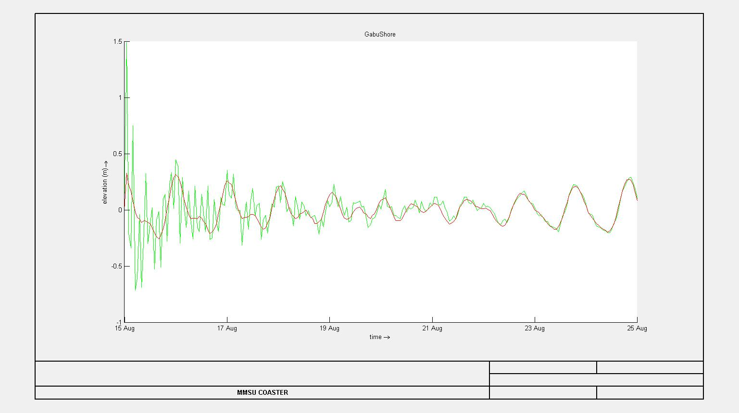
Coaster Storm Surge Model on Padsan

Slide 28
Model Deliverables
Model Configuration and Model Validation
New Model: Lagben River to Shoreline

Slide 29
Thanks for Listening

